Slide 1
Employee demographic Analysis Dashboard
Created by Prachi paliwal

Slide 2
overview
Dataset link - :
Data cleaning - : Data cleaning for the Sales Dataset is essential and involves removing duplicates, fixing spelling errors, handling empty rows, and ensuring a uniform monetary format in the "Sales" column. This process ensures data accuracy and integrity, making the dataset suitable for analysis.

Slide 3
Analysis

Slide 4
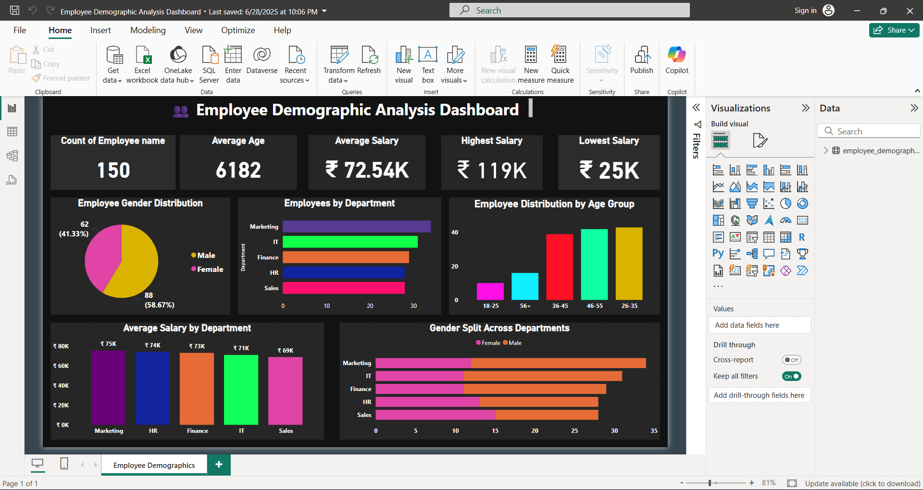
Analysis:
Total Employee Count: There are 150 employees in the organization ,indicating a medium – sized workforce.
Average Age: The average age is shown as 6182 , which is likely due to a data entry or formula error. It should be corrected for accurate demographic insights.
Average Salary: The average salary is ₹72.45K , reflecting the general compensation trend across departments.
Highest Salary: The maximum salary offered is ₹119K , which could be from a leadership or highly technical role.
Lowest Salary: The minimum salary is ₹25K , possibly indicating entry – level or intern positions.

Slide 5
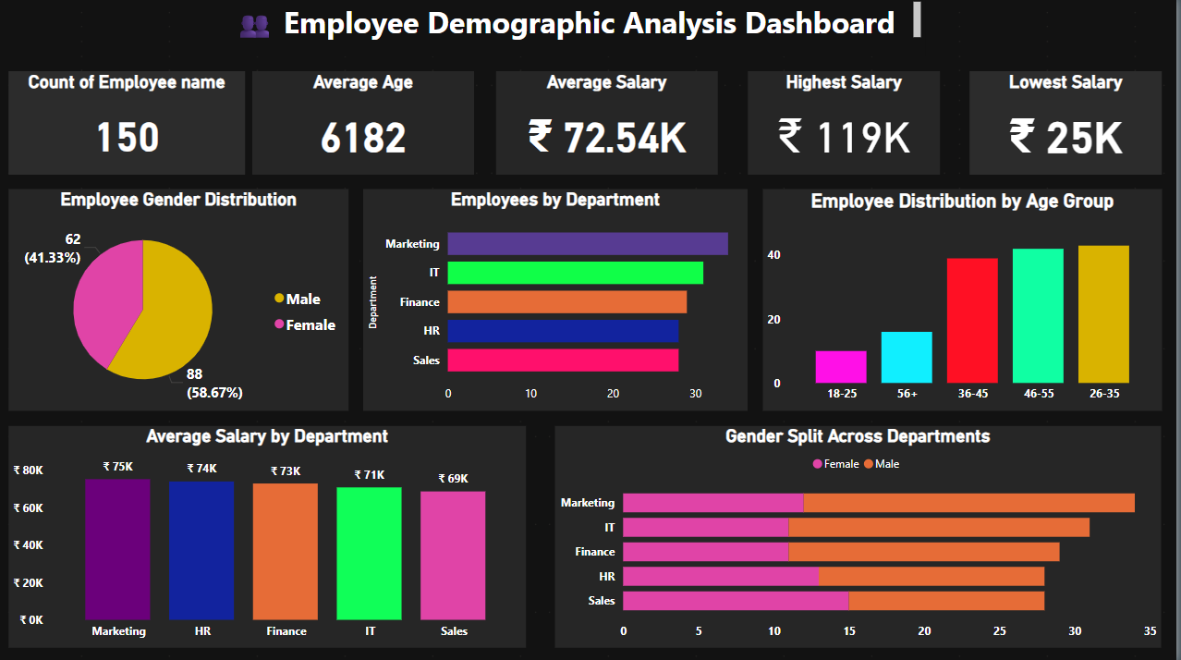
Employee gender distribution:
The workforce consists of 88 females (58.67%) and 62 males (41.33%).
Females represent the majority in the organization.
The gender ratio indicates a relatively diverse and inclusive workforce.

Slide 6
Employee by department:
Marketing has the highest number of employees , slightly above 30 .
IT , Finance , HR and Sales departments each have around 30 employees ,showing a fairly balanced distribution.
Overall , all departments have similar employee strength , indicating equal focus across functions.

Slide 7
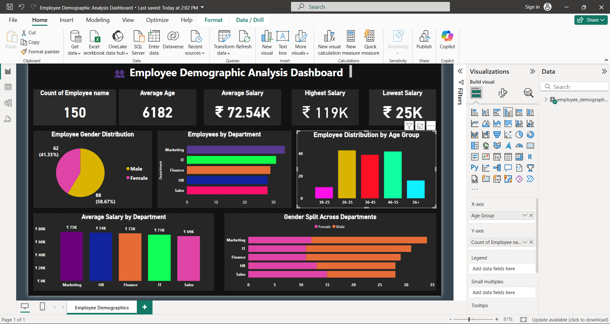
Employee distribution by age group:
The majority of employees fall in the 30-39 age group, indicating a mid-career workforce.
The 20-29 age group is the second highest , reflecting a presence of young professionals or fresher.
Very few employees are in the 40 – 49 and 50+ age groups, suggesting fewer senior or experienced staff.
The age distribution shown the organization is youth – driven with growing talent.

Slide 8
Average salary by department:
The IT department has the highest average salary, indicating high-value technical roles.
Finance and Marketing departments follow closely with competitive average salaries.
HR and Sales departments have relatively lower average salaries, suggesting more entry to mid-level roles.
Overall, salary distribution varies by department, reflecting differences in skill demand and job functions.

Slide 9
Gender split across departments:
Marketing and HR departments have a higher number of female employees indicating female dominated roles.
IT and Finance departments show a more balanced gender distribution.
The Sales department has more male employees , reflecting a male – skewed workforce in that area.
Overall, there is a visible gender diversity, but some departments still show gender concentration.

